Slide 1
Speed Book Talks
Mrs. Miller’s Favs.

Slide 2
Realistic Fiction
Stories that could have actually occurred in a believable setting that are not actually real.
13 Reasons why by Jay Asher
Looking for Alaska by John Green
Hatchet by Gary Paulsen

Slide 3
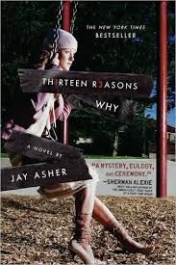
13 Reasons Why by Jay Asher
When Clay Jenson plays the cassette tapes he received in a mysterious package, he's surprised to hear the voice of dead classmate Hannah Baker. He's one of 13 people who receive Hannah's story, which details the circumstances that led to her suicide.

Slide 4
Dystopian
Society is the bad guy and usually works against the aims and goals of the hero by obsessively controlling everything.
Legend by Marie Lu
1984 by George Orwell
The giver by Lois Lowry

Slide 5
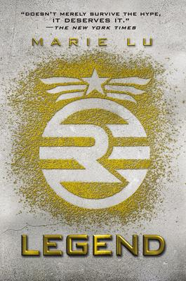
Legend by Marie Lu
June, the Republic’s prodigy, and Day, the Republic’s most wanted criminal would never have met under normal circumstances. But when June’s brother is murdered, Day is the prime subject, and June’s new target.

Slide 6
Science fiction
Based on imagined future scientific or technological advances and major social or environmental changes.
The 5th Wave by Rick Yancey
Ender’s Game by Orson Scott Card
The Road by Cormac MacCarthy

Slide 7
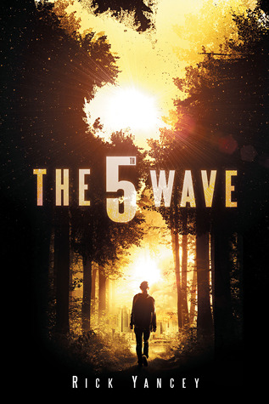
The 5th Wave by Rick Yancey
After the 1st wave, only darkness remains.
After the 2nd, only the lucky escape.
And after the 3rd, only the unlucky survive.
After the 4th wave, only one rule applies: trust no one.

Slide 8
Fantasy
A genre of fiction that commonly uses magic and other supernatural phenomena as a primary plot element, theme, or setting.
Shadow and Bone by Leigh Bardugo
Lord of the Rings by J.R.R. Tolkien
Harry Potter by J.K. Rowling

Slide 9
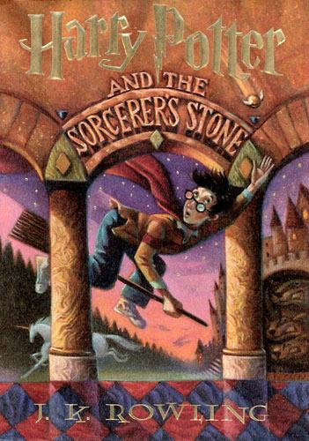
Harry Potter by J.R.R. Tolkien
Harry Potter grows up an orphan, raised by his dominating Aunt and Uncle. At the age of 11, he learns he is in fact no ordinary boy at all and sets out on a journey to save the world and find out who he really is. *Also the best series...EVER.

Slide 10
Romance
These novels focus on relationships above all else, usually the romantic relationship between 2 (or more) people.
Every Day by David Levithan
Anna and the French Kiss by Stephanie Perkins
If I stay by Gayle Forman

Slide 11
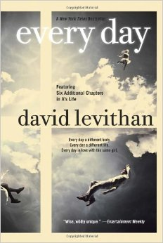
Every Day by David Levithan
Every day a different body. Every day a different life.
There’s never any warning about where it will be or who it will be. A has made peace with that, even established guidelines by which to live: Never get too attached. Avoid being noticed.
Do not interfere.

Slide 12
Action and Suspense
These novels focus on suspense action. They are driven by plot.
Ranger’s Apprentice Novels by John A. Flanagan
Divergent by Veronica Roth
Jurassic Park by Michael Crichton

Slide 13
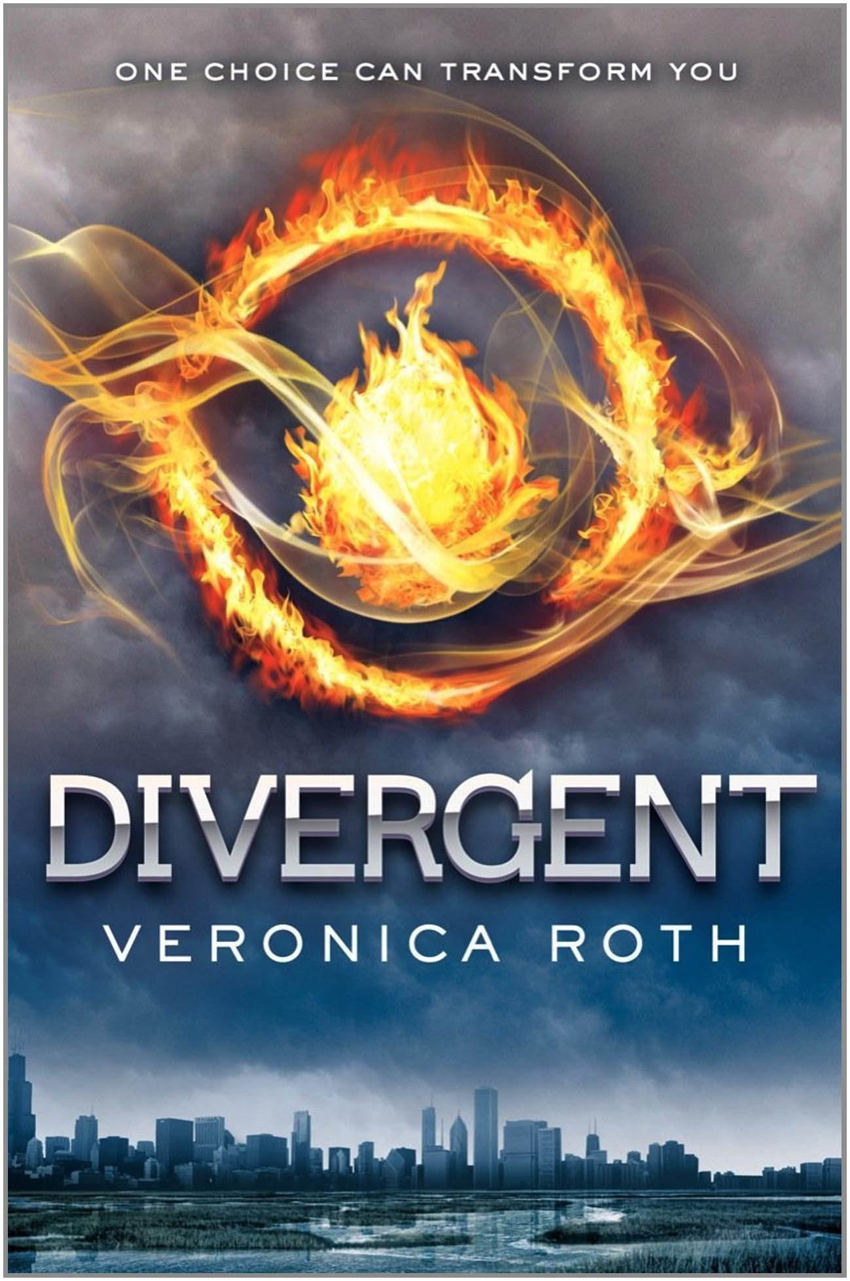
Divergent by Veronica Roth
In Beatrice Prior's world, society is divided into five factions—Candor, Abnegation, Dauntless, Amity, and Erudite.
For Beatrice, the decision is between staying with her family and being who she really is—she can't have both.

Slide 14
Steampunk
A genre of science fiction that typically features machinery rather than advanced technology, often set in the past.
Leviathan by Scott Westerfeld
Etiquette Espionage by Gail Carriger
Cinder by Marissa Meyer

Slide 15
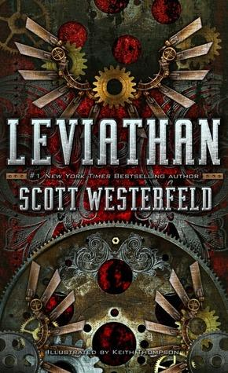
Leviathan by Scott Westerfeld
Prince Aleksander is on the run. His own people have turned on him. His title is worthless. All he has is a battletorn war machine and a loyal crew of men.
Deryn Sharp is disguised as a boy in the British Air Service. She's a brilliant airman. But her secret is in constant danger of being discovered.

Slide 16
Horror
Books seeking to elicit a negative emotional reaction from readers by playing on the audience's primal fears.
Tenderness by Robert Cormier
I am not a Serial Killer by Dan Wells
Unwind by Neal Shusterman

Slide 17
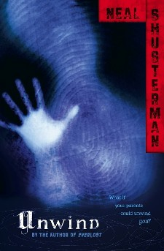
Unwind by Neal Shusterman
The Second Civil War was fought over reproductive rights. The chilling resolution: Life is inviolable from the moment of conception until age thirteen. Between the ages of thirteen and eighteen, however, parents can have their child "unwound," whereby all of the child's organs are transplanted into different donors.

Slide 18
NonFiction: Memoirs, Biographies, Informational
Books about real people, events, situations, or material meant to instruct.
Blink by Malcolm Gladwell
Stiff by Mary Roach
The Hiding Place by Corrie Ten Boom

Slide 19
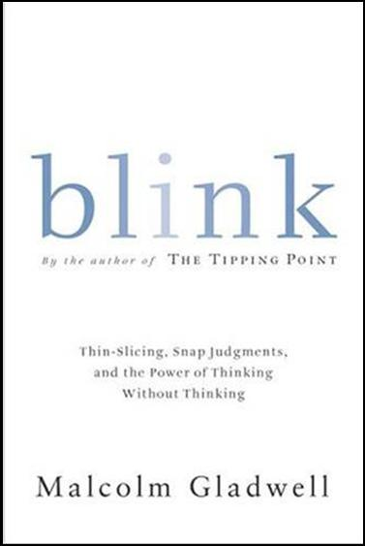
Blink by Malcolm Gladwell
Blink is a book about how we think without thinking, about choices that seem to be made in an instant--in the blink of an eye--that actually aren't as simple as they seem.

