Slide 1
Rhetoric
How to get what you really want.

Slide 2
Rhetoric
Rhetoric is a particular style of speech/argument that focuses on three areas/types of evidence:
Ethos
Pathos
Logos

Slide 3
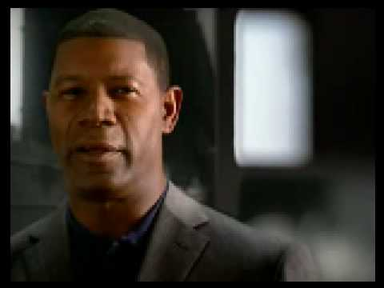
Ethos
A moral argument, focuses on doing what’s right or avoiding what’s wrong. Focuses on your values.

Slide 4
Pathos
An appeal to your emotions. Often plays on pity, anger, sadness, or joy. Uses stories.

Slide 5
Logos
An appeal to logic, focuses on facts and solid evidence.

Slide 6
Audience and Purpose
Audience: Always keep your audience in mind. The type of argument you use, and the amount/type of evidence you give is dependent on your audience.
Purpose: What is your end goal?

