Slide 1
Dual Nature
By: Someone Amazing

Slide 2
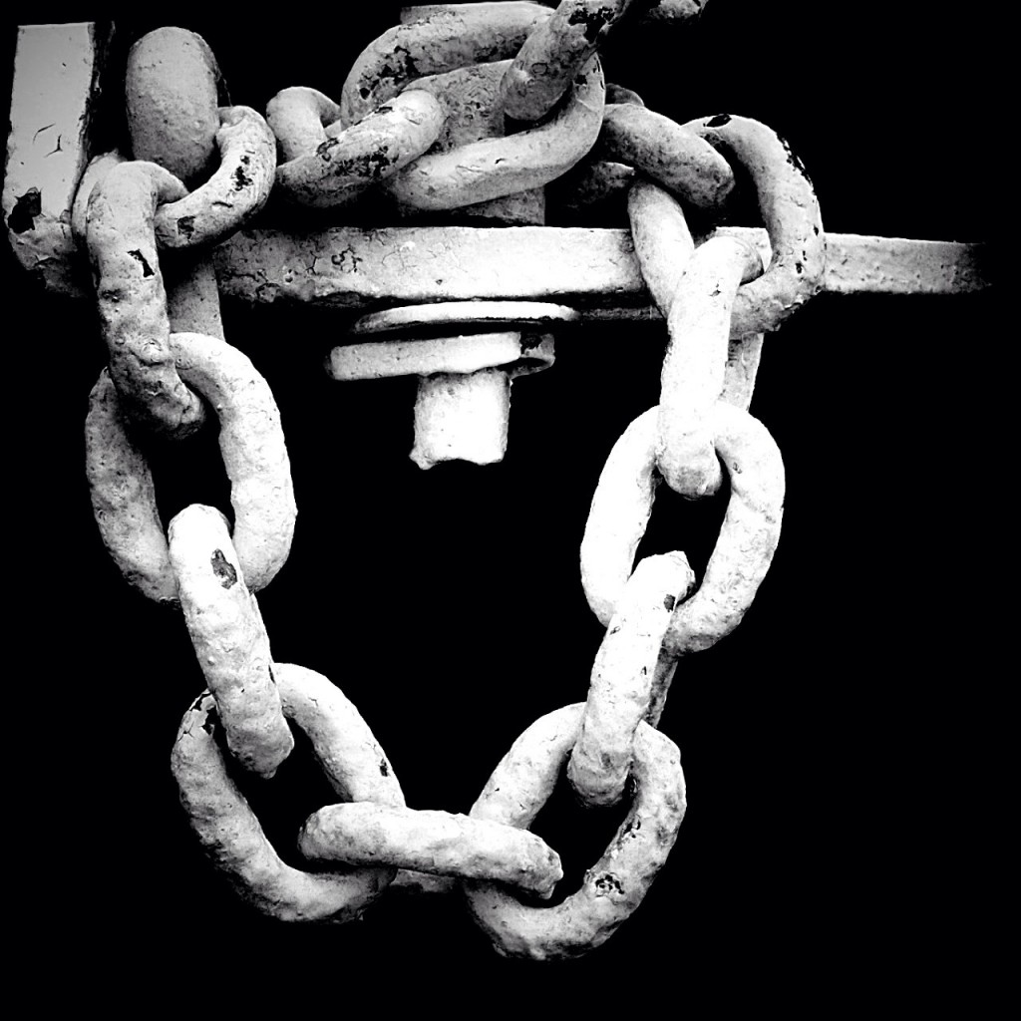
Thus strangely are our souls constructed, and by slight ligaments are we bound to prosperity and ruin.
Victor Frankenstein

Slide 3
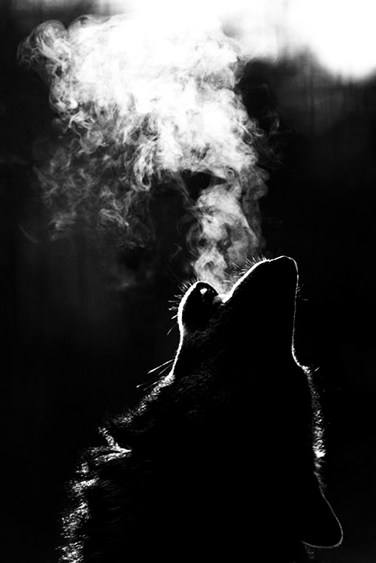
There is love in me the likes of which you've never seen. There is rage in me the likes of which should never escape. If I am not satisfied in the one, I will indulge the other.
The Monster

Slide 4
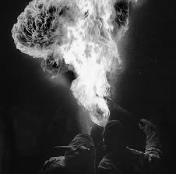
Nothing is so painful to the human mind as a great and sudden change.
Victor Frankenstein

Slide 5
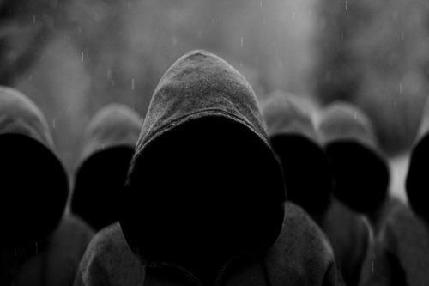
If I cannot inspire love, I will cause fear!
The Monster

Slide 6
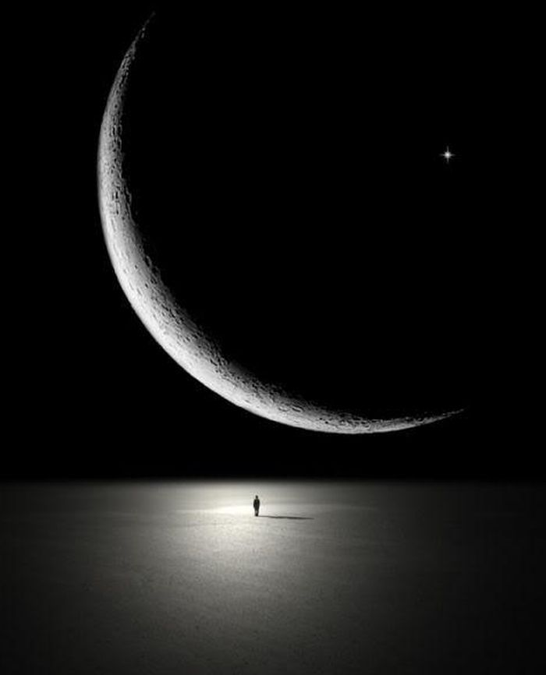
There is something at work in my soul, which I do not understand.
Robert Walton

Slide 7
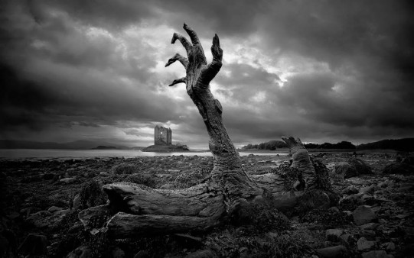
I could not understand why men who knew all about good and evil could hate and kill each other.
The Monster

Slide 8
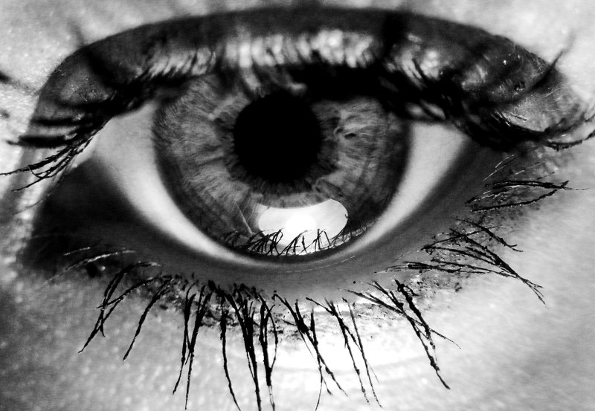
My own mind began to grow, watchful with anxious thoughts.
Robert Walton

Slide 9
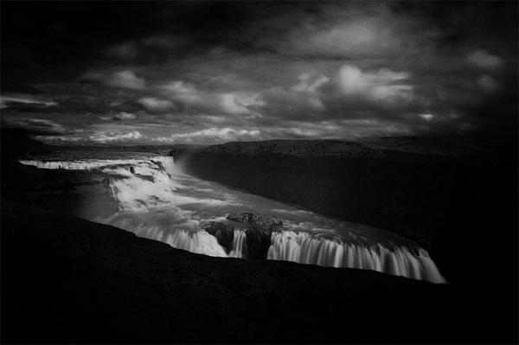
The fallen angel becomes a malignant devil. Yet even that enemy of God and man had friends and associates in his desolation; I am alone.
The Monster

