Slide 1
Rhetoric
The Language of Argument

Slide 2
Know your Audience
Audience: Always keep your audience in mind. The type of argument you use, and the amount/type of evidence you give is dependent on your audience.

Slide 3
Rhetoric
Rhetoric is a particular style of speech/argument that focuses on three areas/types of evidence:
Ethos
Pathos
Logos

Slide 4
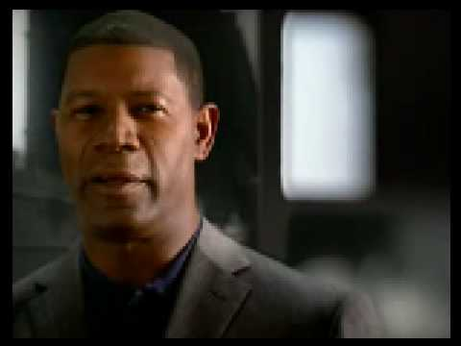
Ethos
A moral argument, focuses on doing what’s right or avoiding what’s wrong. Focuses on your values.

Slide 5
Pathos
An appeal to your emotions. Often plays on pity, anger, sadness, or joy. Uses stories.

Slide 6
Logos
An appeal to logic, focuses on facts and solid evidence.

Slide 7
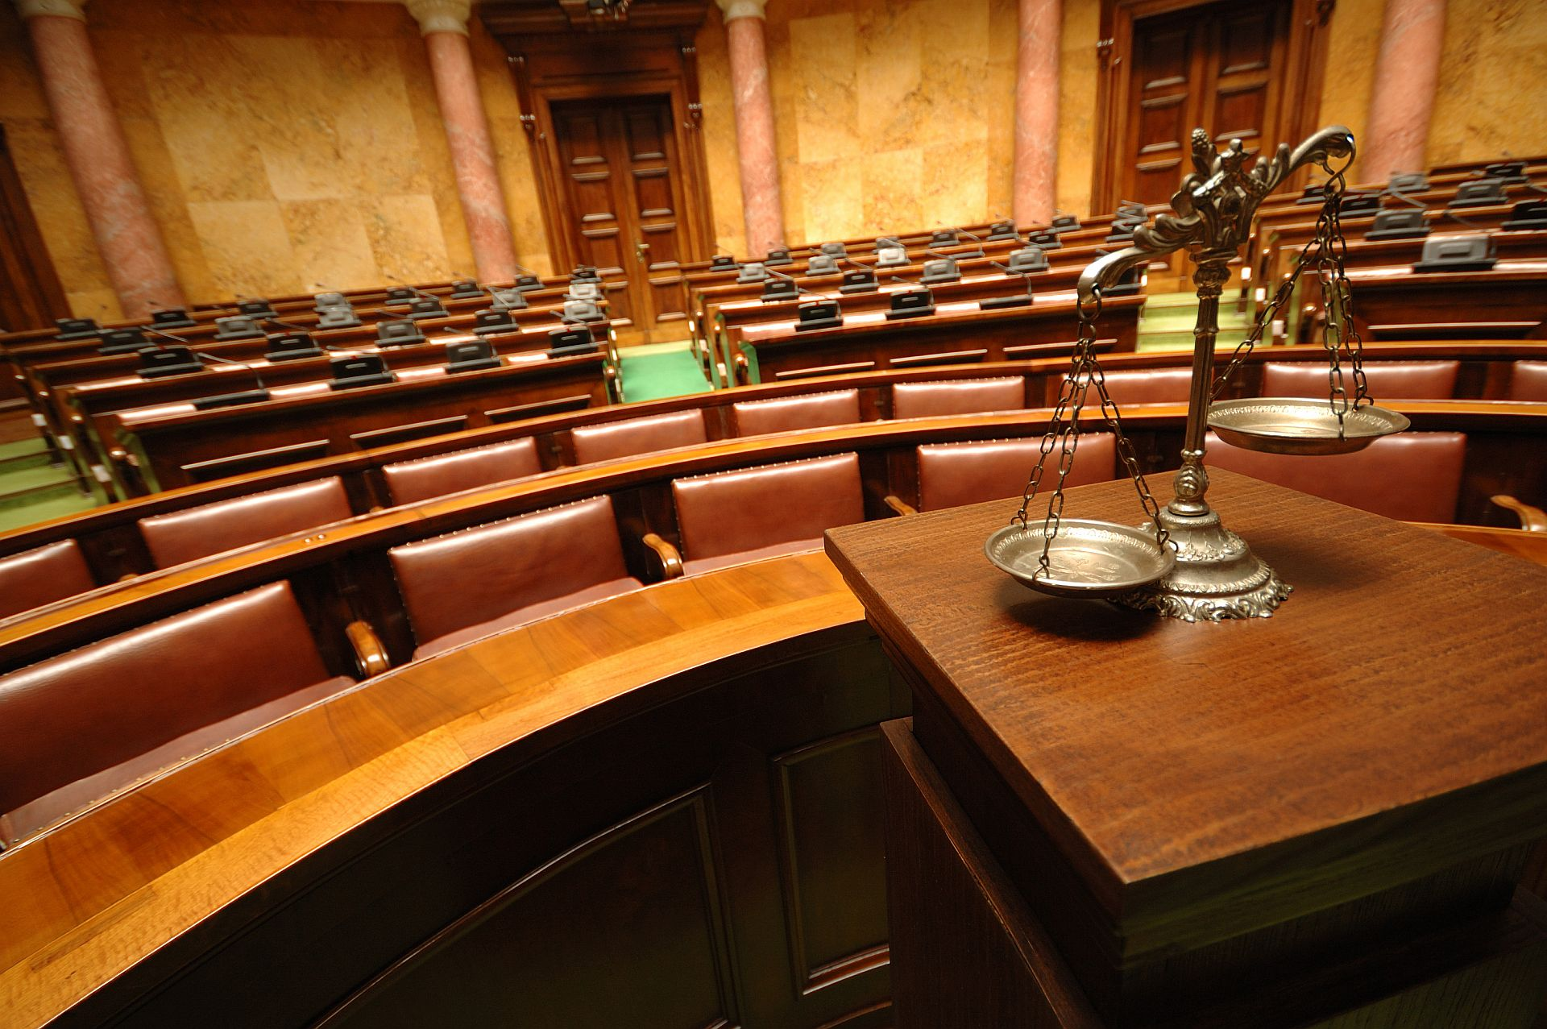
Law School Etiquette
-If the facts support your case, argue the facts (logos)
-If the law supports your case, argue the law (ethos)
-If neither the facts, nor the law support your case, pound on the desk (pathos)

Slide 8
Purpose
Always keep the end goal in mind.
-Are you proving that you are correct?
-Are you trying to persuade someone to do something?
-Are you trying to sell a product?
-Are you trying to get out of trouble?
-Are you trying to get something you want?

Slide 9
Claim
A statement of your stance (where you stand) on the issue.
Example: We should be given an extra minute of passing time in the hallways.

Slide 10
Evidence
Facts and information that validate the claim.
Example: Getting from class to class takes at least 5 minutes, there’s not enough time to go to the restroom or get a drink, there’s not enough time to talk with a teacher after class if you have questions.

Slide 11
Warrant
Explains how the evidence is linked to the claim.
Example: This evidence shows that more passing time is required in order to get everything done and still be to class on time.

Slide 12
Argument Practice (to 2:11)

